Slide 1
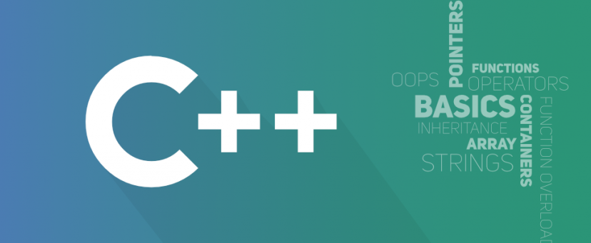
Object Oriented Programming
António J. R. Neves
DETI/UA
Sessão 6

Slide 2
Contents
C++ classes
Attributes and functions
Constructors
Destructors
Operator overloading
static members
const
lvalue and rvalue
lvalue reference and rvalue reference
Copy / Move Constructor
Assignment operator

Slide 3
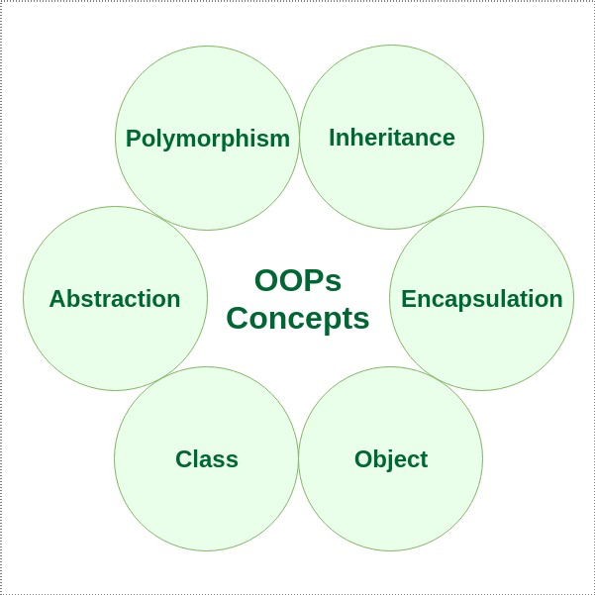
OOP
https://www.geeksforgeeks.org/object-oriented-programming-in-cpp

Slide 4
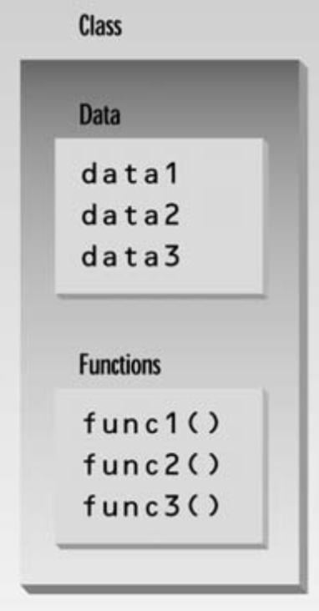
Class
We learned about structures, which provide a way to group data elements
We learned about functions, which organize program actions into named entities
Placing data and functions together into a single entity - class - is a central idea in object-oriented programming
The data items within a class are called data members
Member functions are functions that are included within a class
An object is an instance of a class

Slide 5
Example
Counter.h
#ifndef INC_07_COUNTER_H
#define INC_07_COUNTER_H
#include <iostream>
class Counter {
private:
unsigned int count;
public:
Counter();
Counter(int n);
~Counter();
void increment();
void increment(int n);
int getCount();
};
#endif //INC_07_COUNTER_H
Counter.cpp
#include <iostream>
#include "Counter.h"
Counter::Counter(){
count = 0;
}
Counter::Counter(int n){
count = n;
}
Counter::~Counter() {
}
void Counter::increment(){
count++;
}
void Counter::increment(int n){
count += n;
}
int Counter::getCount(){
return count;
}

Slide 6
private and public
A key feature of object-oriented programming is data hiding
Data hiding means hiding data from parts of the program that don’t need to access it
The primary mechanism for hiding data is to put it in a class and make it private
Private data or functions can only be accessed from within the class
Public data or functions, on the other hand, are accessible from outside the class
Usually the data within a class is private and the functions are public
The data is hidden so it will be safe from accidental manipulation, while the functions that operate on the data are public so they can be accessed from outside the class

Slide 7
Constructors
It is convenient if an object can initialize itself when it’s first created
Automatic initialization is carried out using a special member function called a constructor
A constructor is a member function that is executed automatically whenever an object is created
The most common tasks a constructor carries out is initializing data members
There are some unusual aspects of constructor functions
They have exactly the same name as the class of which they are members
No return type is used for constructor
A default constructor does not have any parameter, but if we need, a constructor can have parameters.

Slide 8
Initialization Lists
In case of parameterized constructor, we can use following syntax to initialize the fields
Counter(int n) : count(n)
{...}
The initialization takes place following the member function declarator but before the function body
The value is placed in parentheses following the member data
If multiple members must be initialized, they’re separated by commas
someClass(int a, int b, int c) : m1(a), m2(b), m3(c)
{...}

Slide 9
Copy constructor
The copy constructor is a constructor which creates an object by initializing it with an object of the same class, which has been created previously
The copy constructor is used to:
Initialize one object from another of the same type
Copy an object to pass it as an argument to a function
Copy an object to return it from a function
If a copy constructor is not defined in a class, the compiler itself defines one
The class must have a copy constructor if pointer variables and some dynamic memory allocations are used
Counter::Counter(const Counter& c){ count = c.count; } | // main function Counter c3 = c2;

Slide 10
Destructor
A destructor is a special member function of a class that is executed whenever an object of it's class goes out of scope or whenever the delete expression is applied to a pointer to the object of that class
A destructor will have exact same name as the class prefixed with a tilde (~) and it can neither return a value nor can it take any parameters
Destructor can be very useful for releasing resources before coming out of the program like closing files, releasing memories etc

Slide 11
Using the class
#include <iostream>
#include "Counter.h"
using namespace std;
int main() {
Counter c1;
c1.increment();
cout << "getCount of obj c1: " << c1.getCount() << endl;
Counter c2(10);
c2.increment(5);
cout << "getCount of obj c2: " << c2.getCount() << endl;
Counter c3 = c2; // copy constructor
cout << "getCount of obj c3: " << c3.getCount() << endl;
cout << "Fim do programa!\n";
return 0;
}

Slide 12
Operator overloading
We can redefine or overload most of the built-in operators available in C++
Overloaded operators are functions with special names: the keyword operator followed by the symbol for the operator being defined
Like any other function, an overloaded operator has a return type and a parameter list
Most overloaded operators can be defined as ordinary class member functions:
Counter operator + (const Counter& c); Counter operator - (const Counter& c); | Counter Counter::operator +(const Counter& c){ Counter tmp; tmp.count = count + c.getCount(); return tmp; } ...

Slide 13
Operator overloading
C++ is able to input and output the built-in data types using the stream extraction operator >> and the stream insertion operator <<
The stream insertion and stream extraction operators also can be overloaded to perform input and output for user-defined types like an object
It is important to make operator overloading function a friend of the class because it would be called without creating an object
// .h
friend std::ostream& operator << (std::ostream&, const Counter& c);
// .cpp
std::ostream& operator << (std::ostream& os, const Counter& c){
os << c.getCount();
return os;}

Slide 14
Static members
If a data item in a class is declared as static, only one such item is created for the entire class, no matter how many objects we instantiated
A static data item is useful when all objects of the same class must share a common item of information
A member variable defined as static has characteristics similar to a normal static variable: its lifetime is the entire program - it continues to exist even if there are no objects of the class
Example: suppose an object needed to know how many other objects of its class were in the program - in this case a static integer variable could be included as a member of the class and all the objects would have access to this variable and see the same value

Slide 15
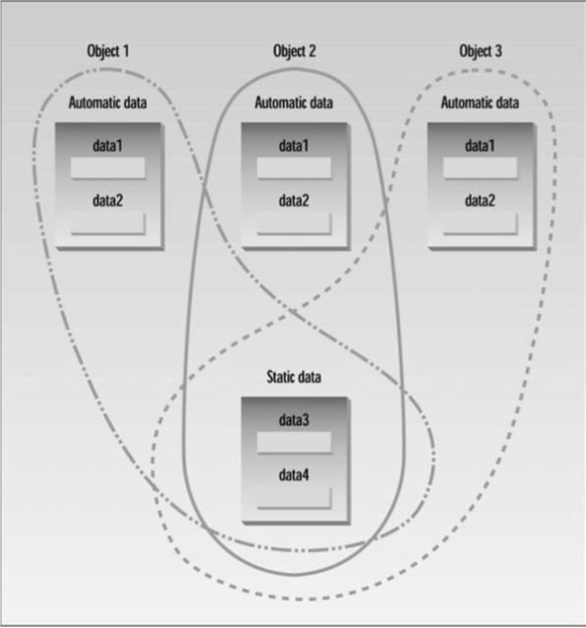
Static members

Slide 16
Example
Counter.h
#ifndef INC_07_COUNTER_H
#define INC_07_COUNTER_H
#include <iostream>
class Counter {
private:
unsigned int count;
static int nCounters;
public:
Counter();
Counter(int n);
~Counter();
...
};
Counter.cpp
#include <iostream>
#include "Counter.h"
Counter::nCounters = 0;
Counter::Counter(){
count = 0;
nCounters++;
}
Counter::Counter(int n){
count = n;
nCounters++;
}
Counter::~Counter() {
}
...

Slide 17
static function members
By declaring a function member as static, you make it independent of any particular object of the class
A static member function can be called even if no objects of the class exist
static functions are accessed using only the class name and the scope resolution operator ::
A static member function can only access static data member, other static member functions and any other functions from outside the class
Example:
// main.cpp
cout << "There are " << Counter::getNCounters() << " counters\n";

Slide 18
Example
Counter.h
#ifndef INC_07_COUNTER_H
#define INC_07_COUNTER_H
#include <iostream>
class Counter {
private:
unsigned int count;
static int nCounters;
public:
Counter();
Counter(int n);
~Counter();
static int getNCounters();
...
};
Counter.cpp
#include <iostream>
#include "Counter.h"
int Counter::nCounters = 0;
Counter::Counter(){
count = 0;
nCounters++;
}
Counter::Counter(int n){
count = n;
nCounters++;
}
Counter::~Counter() {
}
int Counter::getNCounters(){
return nCounters;
}
...

Slide 19
Const
We have seen several examples of const used on normal variables to prevent them from being modified
We saw that const can be used with function arguments to keep a function from modifying a variable passed to it by reference
We can introduce some other uses of const: on member functions, on member function arguments, and on objects.
A const member function guarantees that it will never modify any of its class’s member data - a function is made into a constant function by placing the keyword const after the declaration and definition
Member functions that do nothing but acquire data from an object are obvious candidates for being made const, because they don’t need to modify any data

Slide 20
Const
Recall: if an argument is passed to an ordinary function by reference, and you don’t want the function to modify it, the argument should be made const in the function declaration (and definition) - this is true of member functions as well
We have that we can apply const to variables of basic types such as int to keep them from being modified - in a similar way, we can apply const to objects of classes
When an object is declared as const, you can’t modify it
In a const object we can use only const member functions with it, because they’re the only ones that guarantee not to modify it

Slide 21
Function Templates
Templates make it possible to use one function or class to handle many different data types
Function templates is a way to write such a function just once, and have it work for many different data types
Example: defines a template version of abs() and then, in main(), invokes this function with different data types
template <class T> T abs(T n) { return (n < 0) ? -n : n; } | int a = -5; long b = -70000L; double c = -9.95 cout << abs(a); cout << abs(b); cout << abs(c);
The template keyword signals the compiler that we’re about to define a function template
The variable following the keyword class (T in the example) is called the template argument (T can be anything, like Type, or anyType, ...)

Slide 22
Function Templates
Function Templates with Multiple Arguments
template <class atype>
int find(atype* array, atype value, int size){
for(int j=0; j<size; j++)
if(array[j]==value)
return j;
return -1;
}
More Than One Template Argument
template <class atype, class btype>
btype find(atype* array, atype value, btype size){
for(btype j=0; j<size; j++)
if(array[j]==value)
return j;
return static_cast<btype>(-1);
}

Slide 23
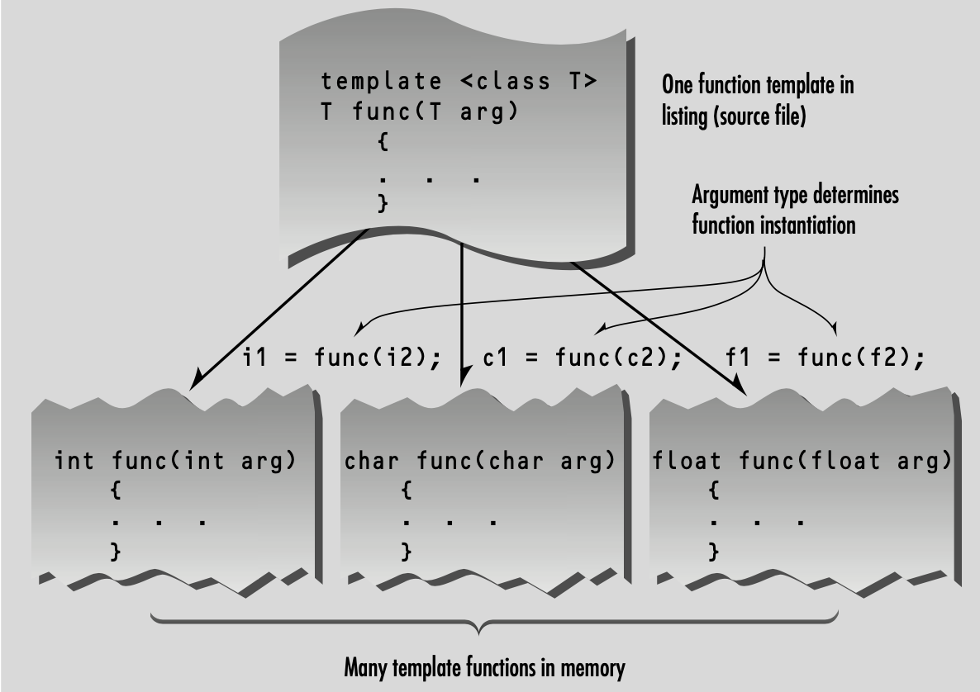
Function Templates
What the compiler does? Code generation doesn’t take place until the function is actually called (invoked) by a statement within the program

Slide 24
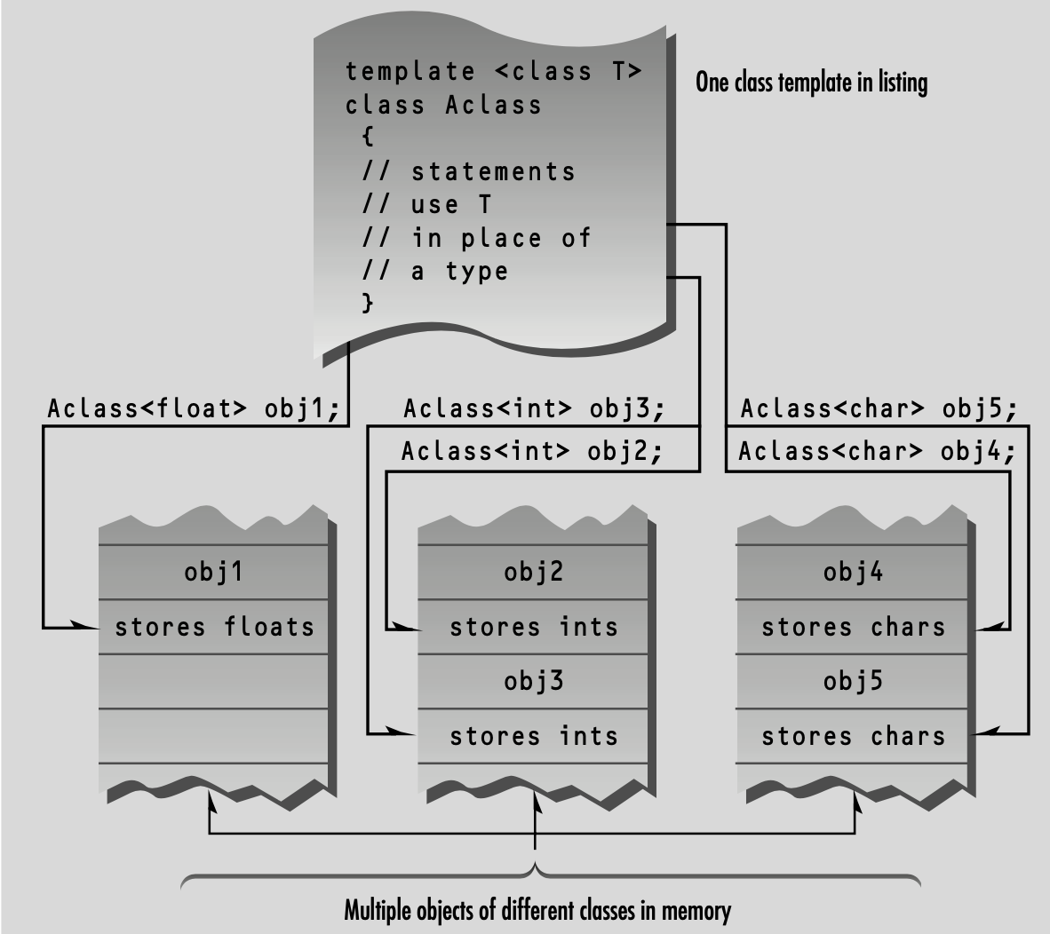
Class Templates
The template concept can be extended to classes
Class templates are generally used for data storage (container) classes - as example we have the containers of the Standard Template Library
Lets take as example of a generic Stack class:

Slide 25
Example: Stack
template <class T> class Stack { private: std::vector<T> elems; public: Stack(const std::vector<T> &e) : elems(elems) {} Stack() {} ~Stack(){ elems.clear(); } | // push an element void push(T const& elem){ elems.push_back(elem); } // pop an element void pop(){ elems.pop_back(); } // return the top element T top() const{ return elems.back(); } // verify if empty. bool empty() const{ return elems.empty(); } };

Slide 26
Example: Stack
The class Stack is presented as a template class
The approach is similar to that used in function templates - the template keyword and class Stack signal that the entire class will be a template
template <class T>
class Stack{
//data and member functions using template argument
};
A template argument, named T in this example, is then used (instead of a fixed data type such as int) everyplace in the class specification where there is a reference to the type of the vector elems
There are three such places: the definition of elems, the argument type of the push() function, and the return type of the pop() function

Slide 27
Example: Stack
Class templates differ from function templates in the way they are instantiated - to create an actual function from a function template, we call it using arguments of a specific type
Classes, however, are instantiated by defining an object using the template argument: Stack<int> s1;
This creates the object s1, a stack that stores numbers of type int - the compiler provides space in memory for this object’s data, using type int wherever the template argument T appears in the class specification and the member functions also operate exclusively on type int
Creating a Stack object that stores objects of a different type, Stack<string> s2; creates not only a different space for data, but also a new set of member functions that operate on type string

Slide 28
Example: main()
Stack<int> s1; // stack of ints
Stack<string> s2; // stack of strings
// manipulate int stack
s1.push(10);
s1.push(20);
cout << "top: " << s1.top() <<endl;
s1.pop();
cout << "top: " << s1.top() <<endl;
// manipulate string stack
s2.push("hello");
s2.push("ppo");
cout << "top: " << s2.top() <<endl;
s2.pop();
cout << "top: " << s2.top() <<endl;
output:
top: 20
top: 10
top: ppo
top: hello

Slide 29
lvalue and rvalue
“l-value” refers to memory location which identifies an object
l-value may appear as either left hand or right hand side of an assignment operator(=)
l-value often represents as identifier
An identifier is a modifiable lvalue if it refers to a memory location and if its type is arithmetic, structure, union, or pointer
r-value” refers to data value that is stored at some address in memory
A r-value is an expression that can’t have a value assigned to it which means r-value can appear on right but not on left hand side of an assignment operator

Slide 30
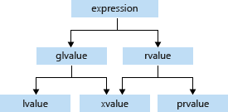
Things get complicated…
A google search on these topics results in the difference between lvalue references and rvalue references, the concept of move semantics, … and all of these are advanced features that require a more detailed study…
Forget about assignments and thingies to the left and the right of the assignment operator
Focus on understanding lvalues and prvalues in a variety of expressions

Slide 31
l-values again
An object is a named region of storage; an lvalue is an expression referring to an object.
Typical example for 4 different manifestations of lvalues:
// Designates an object
int lv1;
// Reference, designates an object
int &lv2 {lv1}
// Pointer, designates an object
int *lv3;
// Function returning a reference, designates an object
int &lv4() {
return lv1;
}
Class instances are objects; references and pointers to instances and members are also objects
An lvalue is an expression that ultimately locates the object in memory.

Slide 32
PRvalue
A prvalue represents a direct value.
Whenever a glvalue appears in a context where a prvalue is expected, the glvalue is converted to a prvalue.
How do we get a value (prvalue) from the lvalue rv2? By converting (evaluating) it!
The rvalues are NOT the objects, nor the functions. The rvalues are what is ultimately used:
The value of a literal (not related to any object).
The value returned by a function
The value of a temporary object is required to hold the result of evaluating an expression

Slide 33
Xvalue
C++ distinguishes between two different references:
int& // lvalue reference
int&& // rvalue reference
Their functionality is semantically exactly the same. Yet they are different types! That means that the following overloaded functions are different as well:
int f(int&);
int f(int&&);
A simple attempt to bind references to an lvalue:
int lv1 {42};
int& lvr {lv1}; // Allowed
int&& rvr1 {lv1}; // Illegal
int&& rvr2 {static_cast<int&&>(lv1)};// Allowed
For what? Rather than copying objects, it might be faster (especially for large objects) if object resources can be “moved”.

Slide 34
move semantics
We can implement functions in such a way that rather than copying information, we just move it.
The functions take advantage of the different types of references:
S(const S &&s); // Move Constructor
S& operator=( S &&s); // Move Assignment Operator
We are keeping the original constructor and operator for when the actual parameter is an lvalue.
If we could force the actual parameter to be an rvalue, then we can execute this new constructor or assignment operator!
There actually are a few ways of turning the lvalue into an rvalue:
S s4 {static_cast<S&&>(s3)); // Calls move constructor
s2 = static_cast<S&&>(s4); // Calls move assignment operator
S s4 {std::move(s3)); // Calls move constructor
S2 = std::move(s4); // Calls move assignment operator
xvalues are also known as eXpiring values.

Slide 35
Copy constructor
The copy constructor is a constructor which creates an object by initializing it with an object of the same class, which was created previously
The copy constructor is used to:
Initialize one object from another of the same type
Copy an object to pass it as an argument to a function
Copy an object to return it from a function
If a copy constructor is not defined in a class, the compiler itself defines one
The class must have a copy constructor if pointer variables and dynamic memory allocation are used

Slide 36
Assignment operator
The assignment operator for a class is what allows you to use = to assign one instance to another
If the operator is not defined in the class, the compiler itself defines one
The class should implement it if pointer variables and dynamic memory allocation are used
In general, anytime we need to write a custom copy constructor, we also need to write a custom assignment operator

Slide 37
Example
Counter.h
...
#include <iostream>
class Counter {
...
public:
...
// copy constructor
Counter(const Counter &counter);
// move constructor
Counter(Counter &&counter);
// copy assignment
Counter &operator=(const Counter &c);
//move assignment
Counter &operator=(Counter &&c);
...
};
#endif //INC_07_COUNTER_H
Counter.cpp
#include "Counter.h"
...
Counter::Counter(const Counter &counter) {
counterValue_ = counter.counterValue_;
}
Counter::Counter(Counter &&counter) {
counterValue_ = counter.counterValue_;
counter.counterValue_ = 0; // just to explain
}
Counter & Counter::operator=(const Counter &c) {
counterValue_ = c.counterValue_;
return *this;
}
Counter & Counter::operator=(Counter &&c) {
counterValue_ = c.counterValue_;
c.counterValue_ = 0; // just to explain
return *this;
}

Slide 38
Some links
Constructors - MSF
References
https://en.cppreference.com/w/cpp/language/copy_constructor
https://en.cppreference.com/w/cpp/language/copy_assignment
https://en.cppreference.com/w/cpp/language/move_constructor
https://en.cppreference.com/w/cpp/language/move_assignment

